Slide 1
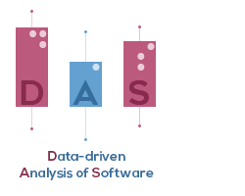



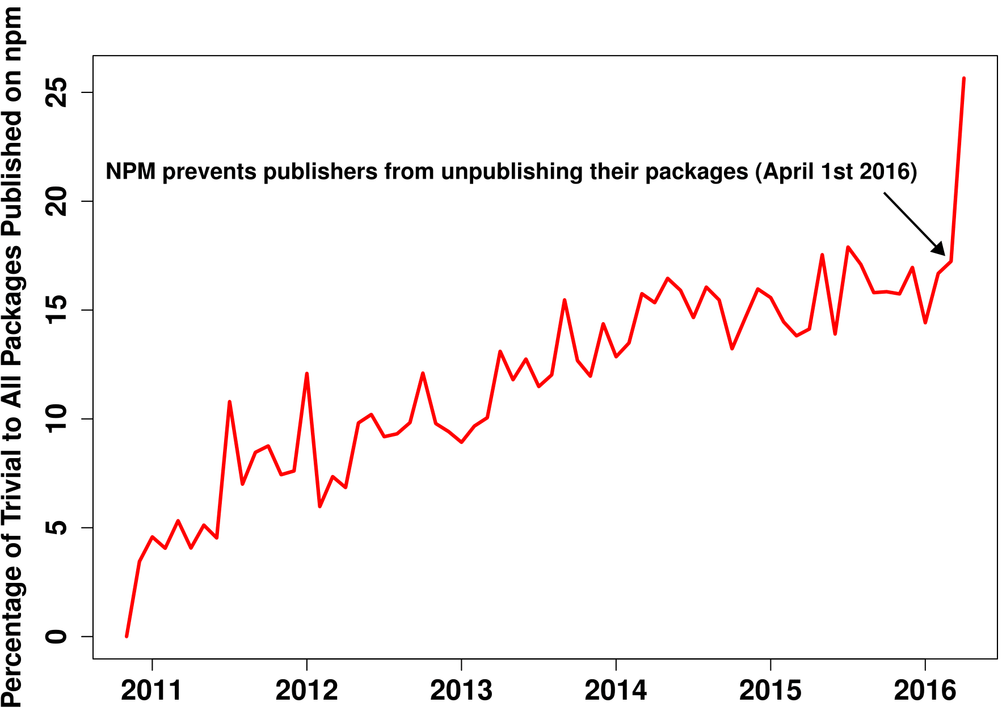
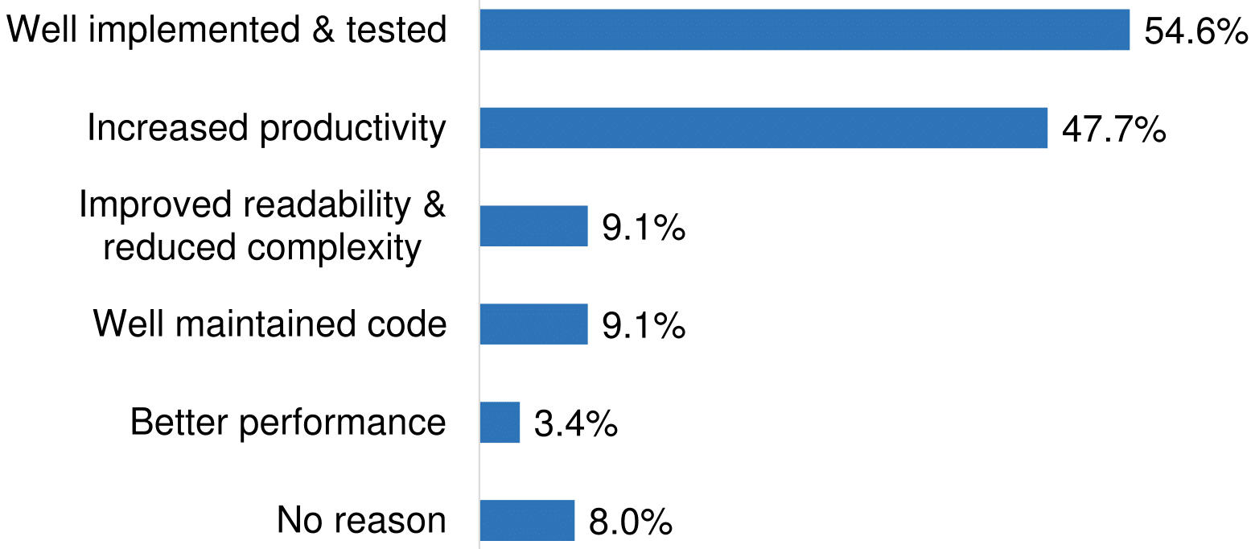
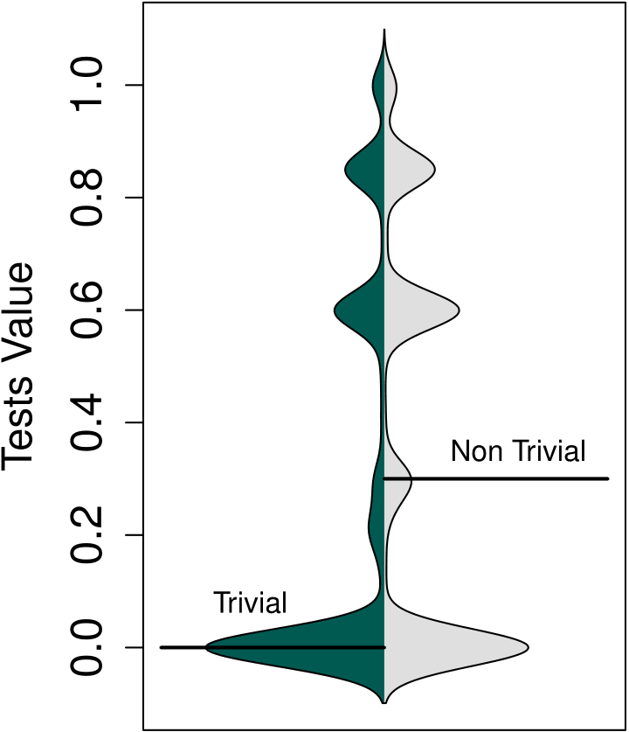
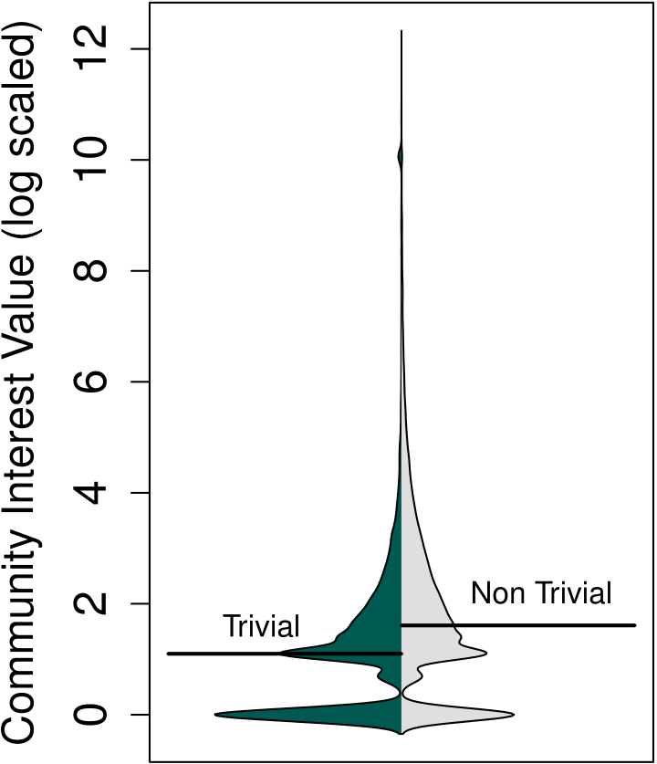
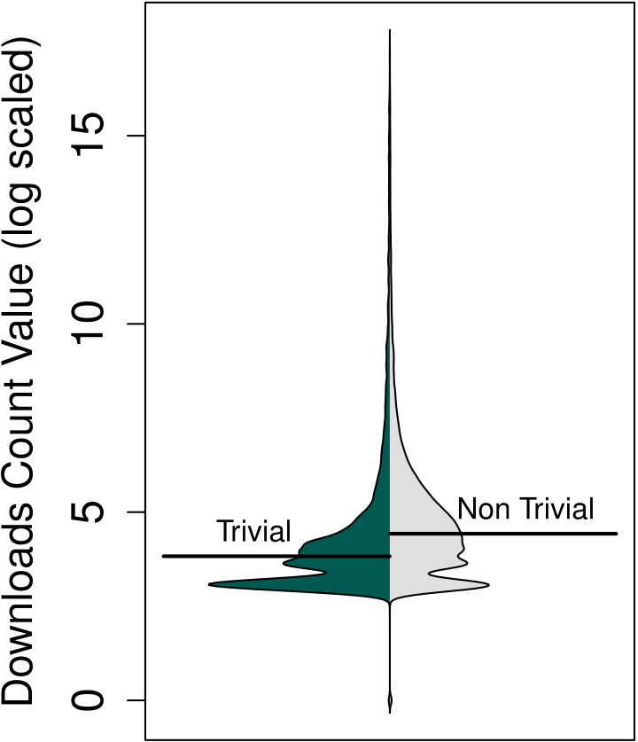
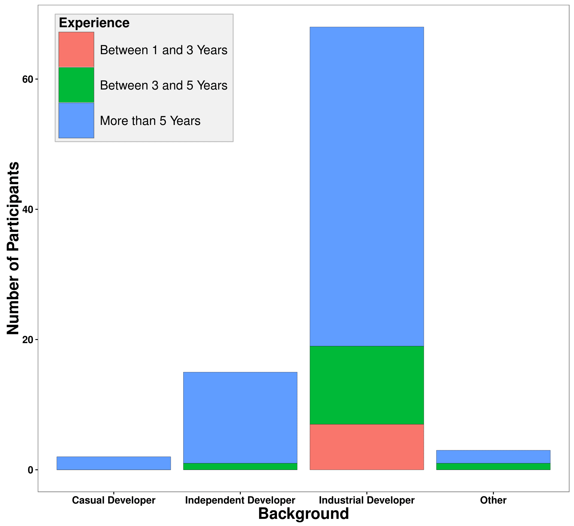
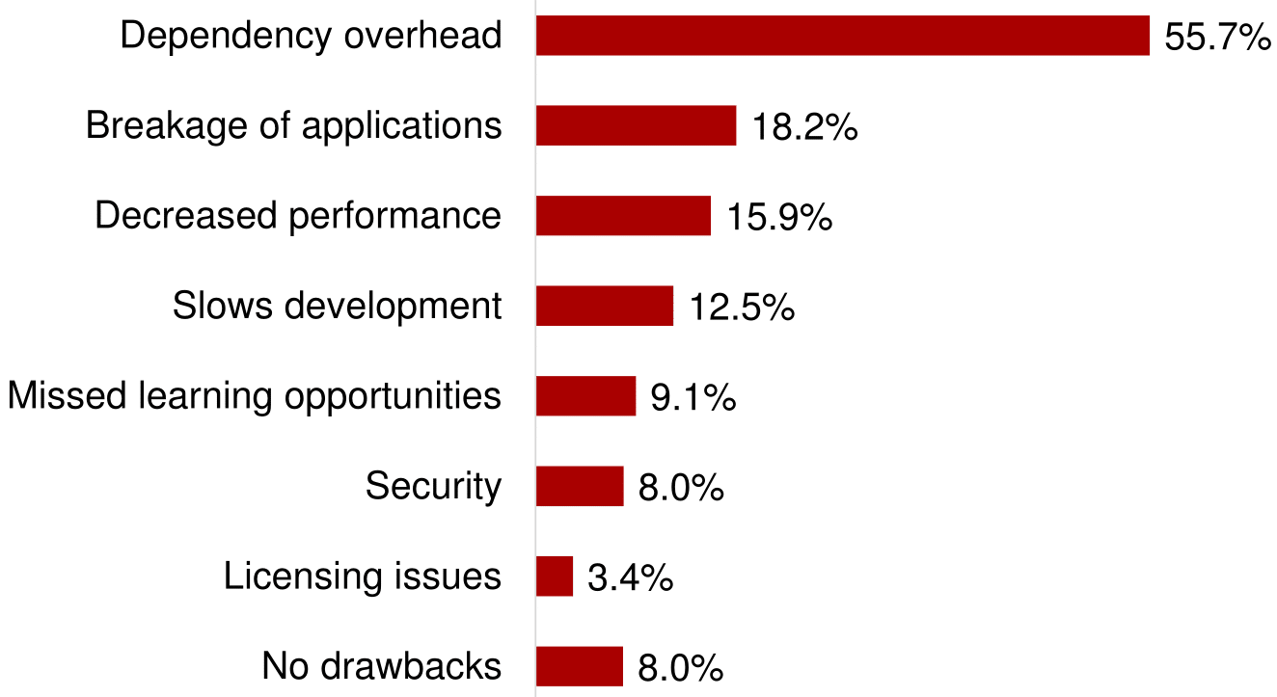
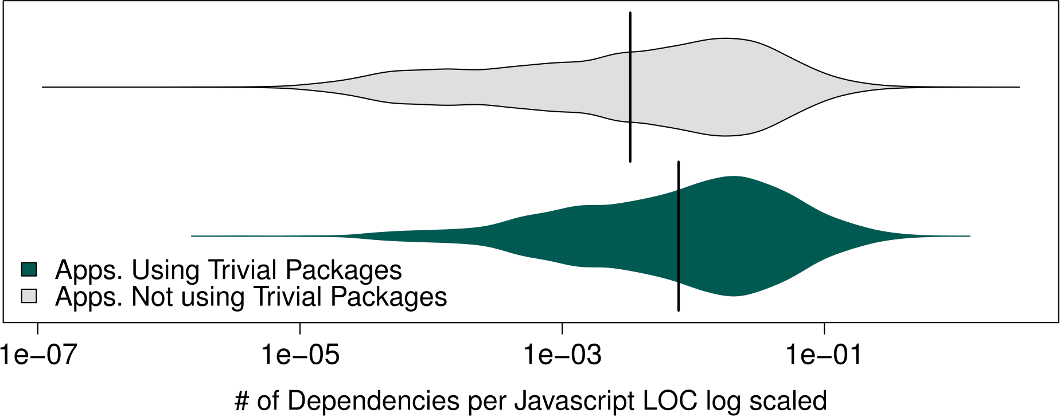
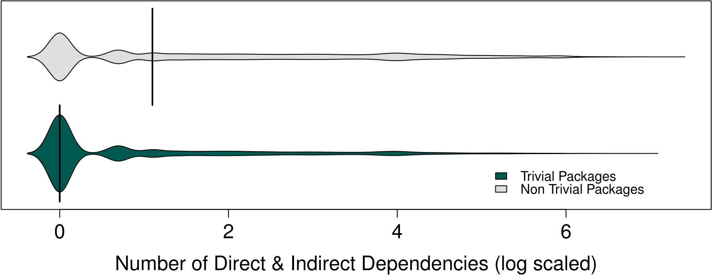
Reasons and Drawbacks of using Trivial npm Packages:
The Developers' Perspective
Rabe Abdalkareem, Olivier Nourry, Sultan Wehaibi, Suhaib Mujahid and Emad Shihab
1
2
3
Developers take on dependencies for trivial tasks, such as checking if a variable is an array. We want to study why developers resort to using a package for trivial packages?
Datasets
What is a trivial package?
Survey based study of 12 developers
Package isarray
38,807 JS Projects
252,996 Packages
1 var toString = {}.toString;
2 module.exports = Array.isArray || function (arr) {
3 return toString.call(arr) == '[object Array]';
4 };
6,990,705 downloads in one week
38,845 trivial packages
4256 projects using trivial packages
Trivial Package = Package < 35 Javascript LOC & Package < 10 Cyclomatic Complexity
4
6
7
Moein Almasi
Developers’ Perspective
Empirical Validation
Reasons
Trivial packages are increasing over time.
11.3% of the top 1,000 most depended on npm packages are trivial.
Top two reasons:
They provide well implemented and tested code and
they increase productivity
Contrary to developers’ perception, only 45.2% of trivial packages actually have tests.
5
Survey based study of 88 node.js developers
Drawbacks
Top two cited drawbacks:
They increase dependency overhead and
They may break their applications.
43.7% of trivial packages have at least one dependency & 11.5% of trivial packages have
> 20 dependencies.

